Slide 1
VRoom: Proposal
Team 2

Slide 2
Contents
1 Overview
2 Features
3 Development

Slide 3
1 Overview
Motivation
Item Introduction
Market Analysis
Expect
Goals
Evaluation

Slide 4


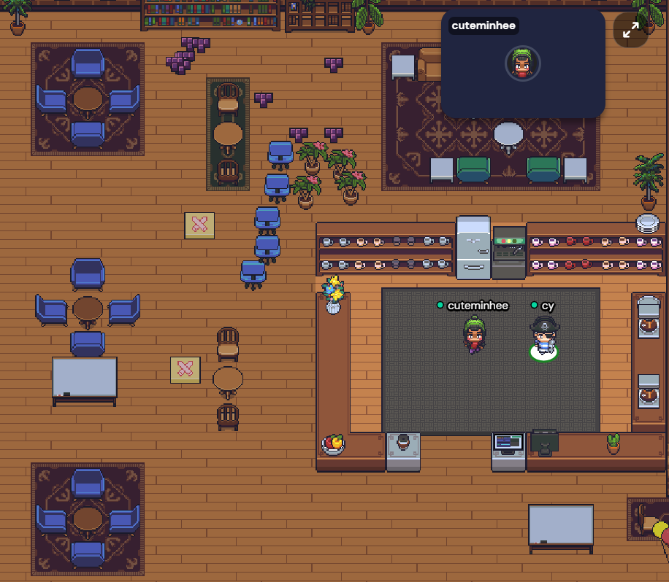
Motivation
Overview
1.1
Because of Corona virus, people are used to online meeting using Zoom, Webex, etc.
However, a lot of people are suffering from Zoom fatigue during online meeting these days.
It is about the exhaustion you feel after any kind of video call.
Therefore, metaverse platforms such as Gather Town are used for online meeting. The main issue of video conferencing is not just to communicate with people far away, but to communicate well so that they do not get tired.

Slide 5

Motivation
Overview
1.1
VRChat is a metaverse platform which offers social VR experiences.
Currently, a 2D metaverse such as Gather Town is being used, so we will make a more realistic world in 3D. Especially, we decided to make a meeting room because we thought the meeting room is the most useful thing in the smart campus.

Slide 6
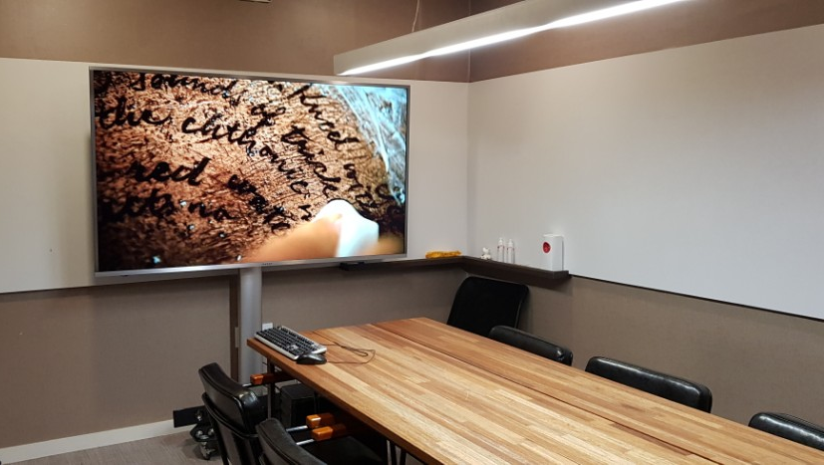
Item Introduction
Overview
1.2
We will make a metaverse meeting room platform: VRoom.
It is the implementation of offline meeting rooms on metaverse.
It provides various features for smooth communication, such as a blackboard where you can write something and share your screen.
With VRChat functionality, hosts who want to invite their teammates can create their own meeting room.
Can be used for
Group project meeting
Group study
Presentation
and other kinds of meetings
Source: http://smarthubline.com/article/%EA%B0%A4%EB%9F%AC%EB%A6%AC/8/57/

Slide 7
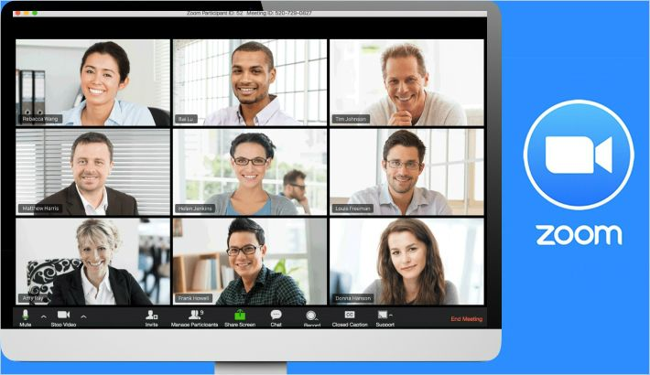
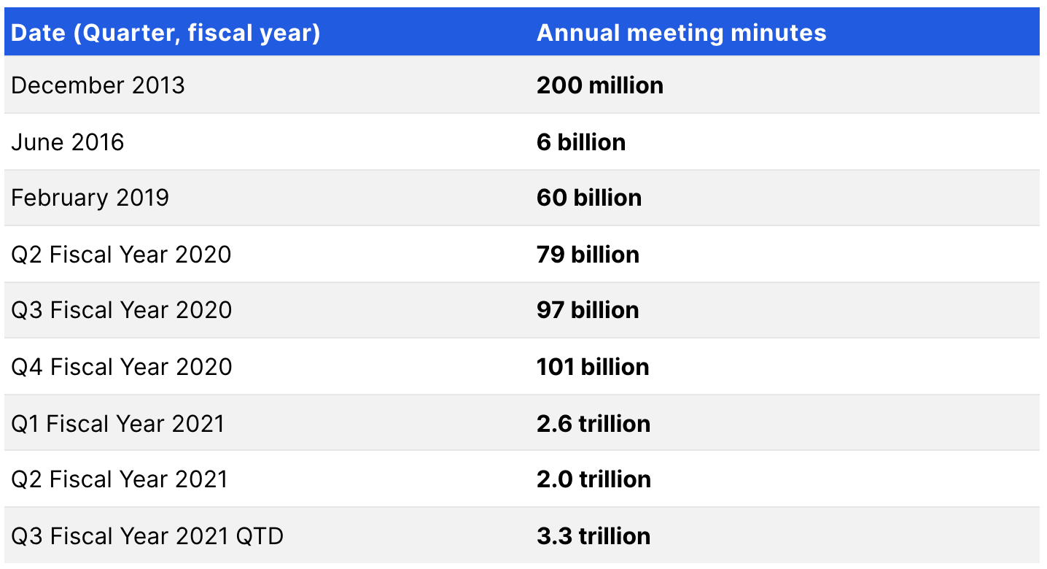
Market Analysis
Overview
1.3
There are many video conference platforms such as Zoom and Webex.
Zoom is still the most used non-face-to-face meeting since the pandemic. But…
‘Zoom fatigue’ Problem
Unconsciously feel that many meeting participants are looking at my face.
Participants repeatedly check their appearance.
You cannot move your body during a meeting.
Source: https://backlinko.com/zoom-users

Slide 8
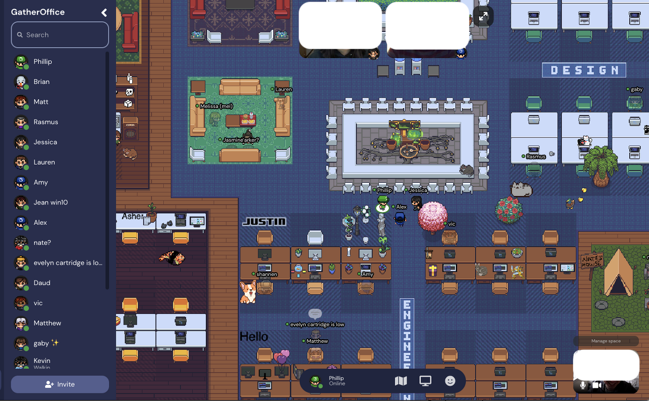
Market Analysis
Overview
1.3
Gather Town - 2D metaverse virtual office
Some of the companies that are tired of video conferences such as Zoom and Webex are moving to Gather Town.
Since its launch in May 2020, it has currently surpassed 1 million users.
Source: https://brunch.co.kr/@uniher/10

Slide 9
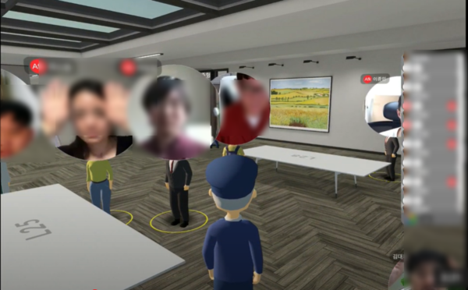
Market Analysis
Overview
1.3
Metapolis - 3D metaverse virtual office for real estate brokerage platform “직방“.
3D metaverse office is already becoming a reality.
Compared to the 2D metaverse office, it gives you more sense of realism and immersion.
They have plans to sell extra offices to other companies and organizations.
Additional Reference:
직방에는 사무실이 없다? 직방 메타버스 사무실 구경하고 옴!
https://youtu.be/n2Pzg-dz-Fo
Source: https://career.zigbang.com/7b7c5981-4457-4be2-b080-39a906d8dfe1

Slide 10
Expect
Overview
1.4
Less Zoom fatigue
L
L
By using 3D, it can reduce the fatigue felt from 2D.
Time saving
T
Preparation time for actual meeting can be reduced.
T
D
Deliver nonverbal expressions
D
It enables users to do non-verbal expressions such as nodding or eye movement. So we feel like we have an actual meeting.

Slide 11
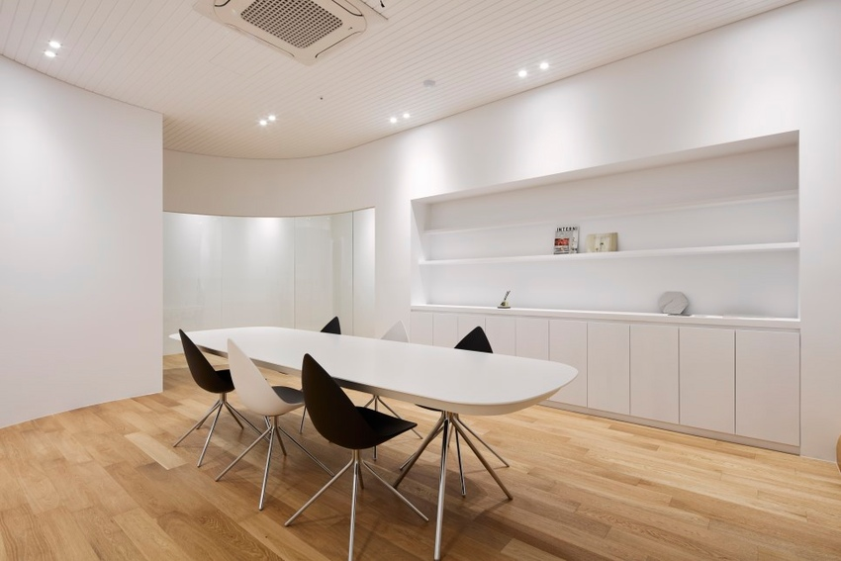
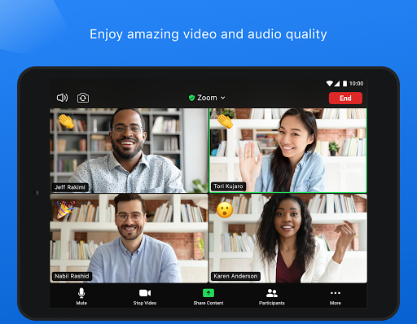
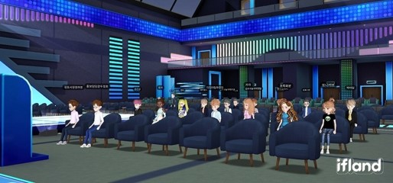
Goals
Overview
1.5
Offline meeting
2D Online meeting
3D Online meeting
Source:
https://ohou.se/cards/1963700?affect_type=CardSearch&affect_id=0&query=%EB%AF%B8%ED%8C%85%EB%A3%B8
https://play.google.com/store/apps/details?id=us.zoom.videomeetings&hl=en_US&gl=US
https://www.hellot.net/mobile/article.html?no=60522

Slide 12
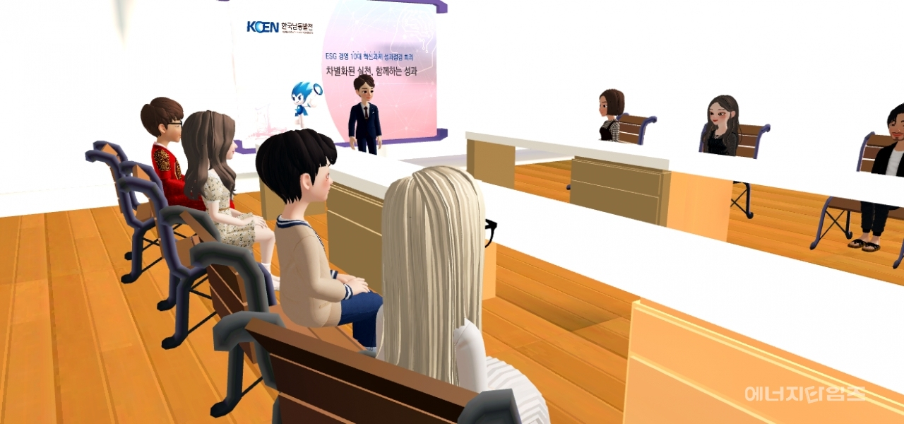
Goals
Overview
1.5
Anyone can make their meeting room.
Anyone can communicate online smoothly.
Source: https://mobile.newsis.com/view.html?ar_id=NISX20210804_0001537111#_enliple
metaverse meeting room

Slide 13
Evaluation
Overview
1.6
Evaluation |  | Score
 |  | 1 | 2 | 3 | 4 | 5
Functionality | Can users communicate well?
 | Does it reflect users’ movement well?
Reliability | Can users access the meeting room where they want to enter well?
 | Can users use the meeting room when there is some empty room?
 | Does it prevent unwanted people from entering the meeting room?
Efficiency | Can users communicate efficiently?
Acceptancy | Can users understand how to use the service?

Slide 14
2 Features
Main Features
Additional Features

Slide 15
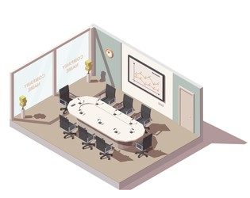
Main Features
Features
2.1
1. Black Board
- 2D Blackboard is available to everyone in the meeting.
- It increases the visibility to help communication.
- By using the pen objects, the user can draw on it.
2. Projector Screen
- Users can share their documents (such as pdfs) with other team members on it.
- It includes the function of a black board and can be implemented as a single object.

Slide 16

Main Features
Features
2.1
3. Calendar
- In some cases, such as a project with a deadline or scheduling next meeting,
a calendar is needed.
- To provide convenience, a simple calendar will be placed inside the meeting room.
4. Voice Chat +
- The VRChat basically provides voice chatting. It allows you to speak whenever you want.
- However, in the VR(or online) meeting room, sometimes hosts should be able to
mute others to concentrate on one’s utterance.
- We will give the mute control to the host to make sure the meeting goes on smoothly.

Slide 17
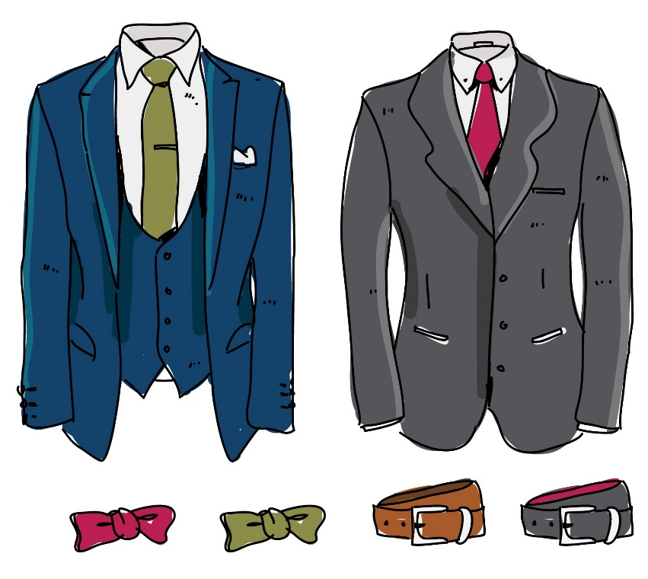
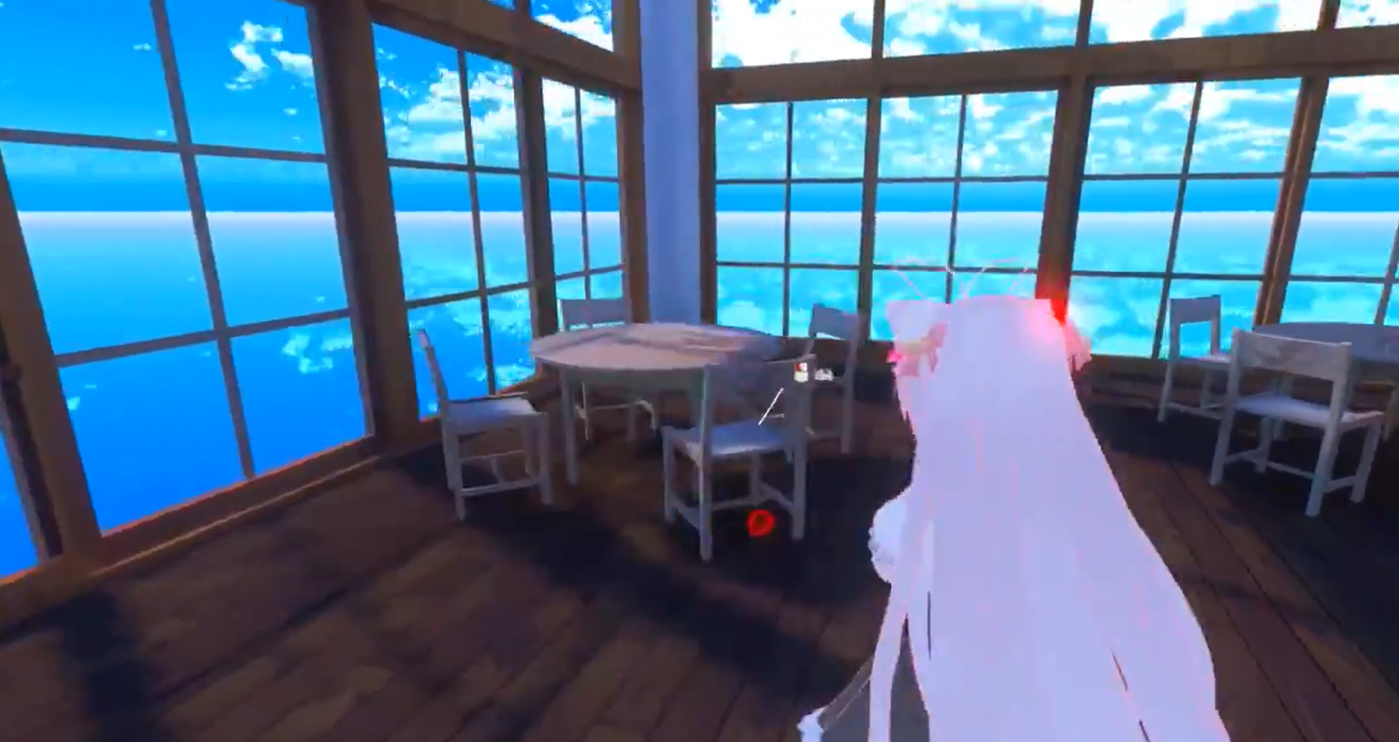
Additional Features
Features
2.2
1. Avatar
- When you enter the room, some avatars that are suitable for
meeting will be provided.
- If you don't like our avatars, you can use your own avatar.
2. Third Person View
- By default, VRChat is fixed as a first-person view.
- Desktop users might feel uncomfortable with this setting.
- We’ll add a third-person perspective so that
each person can freely change their perspective.
https://twitter.com/nano082l/status/1188383261904424960

Slide 18
3 Development
Tools
Role Distribution
Schedule

Slide 19
Tools
Development
3.1
Platform: VRChat
Develop Environment: Unity 2019.4.30f1

Slide 20
Role Distribution
Development
3.2
UI/UX Designer(2D): Kim Jinwoong
designs user interfaces and experiences that users can see at a glance.
UI/UX
Designer(2D)
Modeling(3D)
Role
Modeling(3D): Lee Hyewon, Hong Seongjun
models a 3D meeting room world and avatars.
Developer
Developer: Kim Hongbeen, Lee Jiwoo, Kim Minhee, Seo Chaeyeon
develops core functions that provide VRoom features.

Slide 21
Schedule
Development
3.3
Week 4: Proposal
Week 5: Confirmation of Detailed Features
Week 6: Requirement Investigation for Implementation
Week 7: Tool Study
Week 8: Requirement Specification
Week 9-10: Feature Implementation
Week 11: Feature Integration & Design Specification
Week 12: Code Review
Week 13: Testing
Week 14: Implementation & Final Presentation

